Slide 1
Smart Contracts
Author
Poloz A. E.
SPbU, 2020
Автор
Полоз А. Е.

Slide 2
Accounts
nonce
balance
storageRoot
codeHash

Slide 3


Accounts
Externally owned account
Contract account

Slide 4



Transactions
Fund Transfer Between EOA
Deploy a Contract on Ethereum Network
Execute a Function on a Deployed Contract

Slide 5
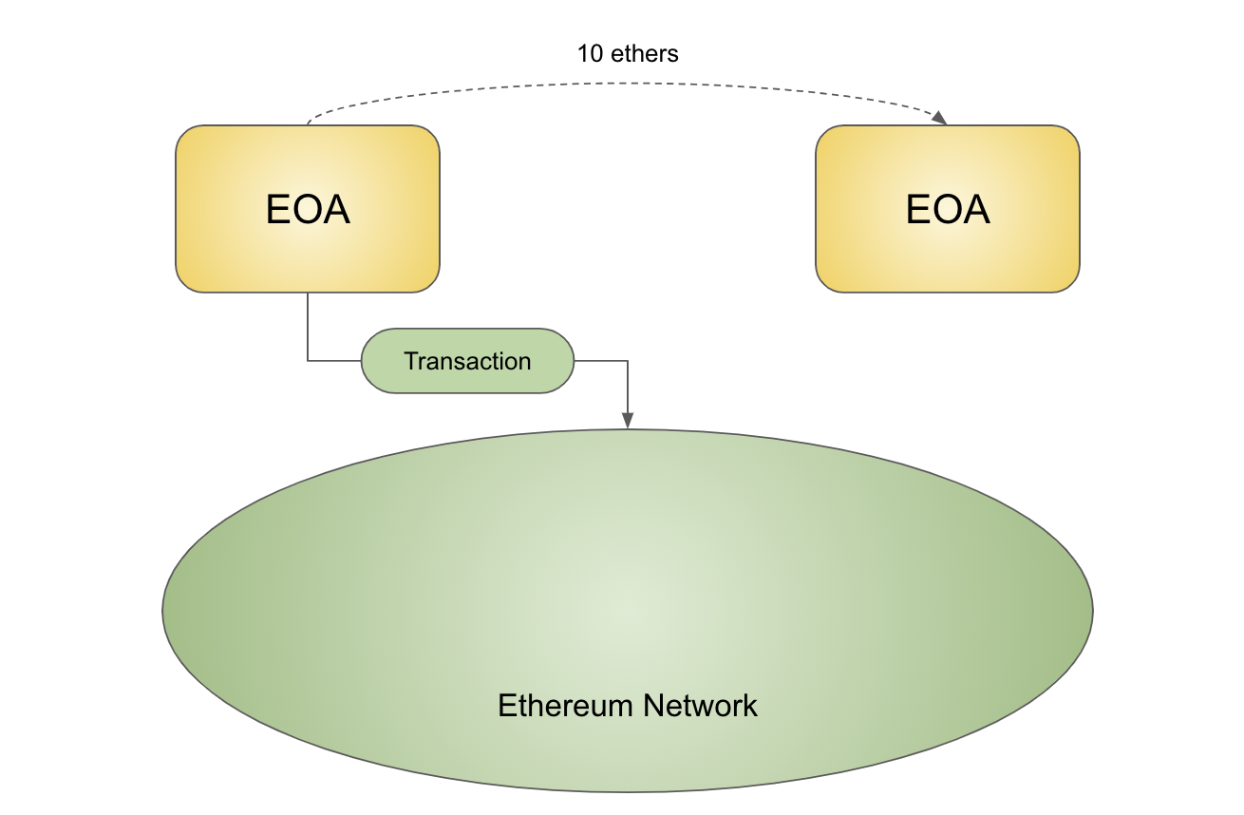
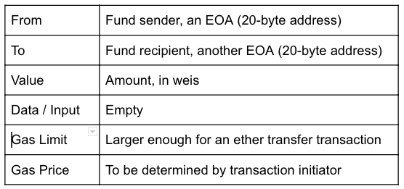
Fund Transfer Between EOA

Slide 6
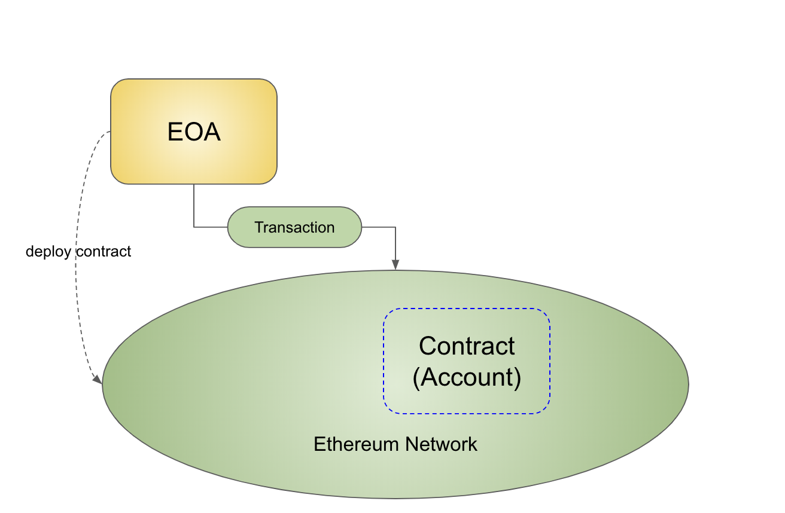
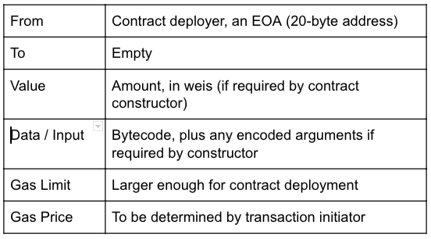
Deploy a Contract on Ethereum Network

Slide 7
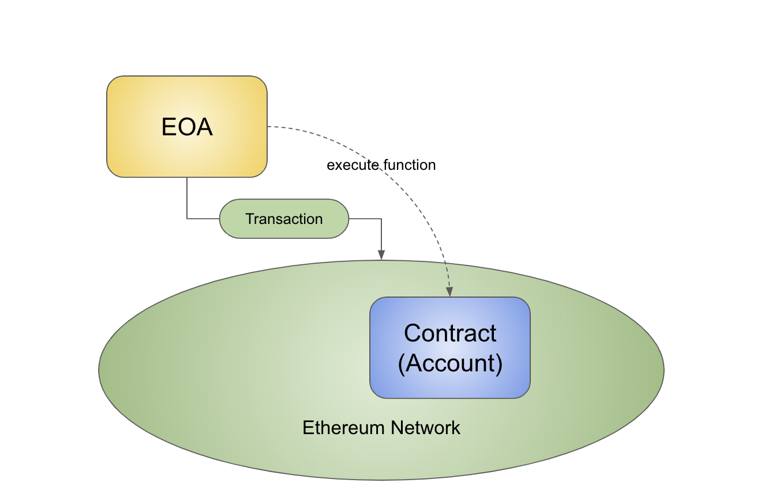
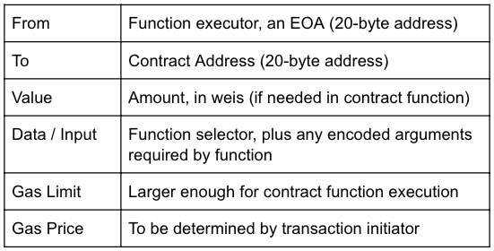
Execute a Function on a Deployed Contract

Slide 8

Smart Contract
A contract is a legal document that binds two or more parties who agree to execute a transaction immediately or in the future.
A smart contract is a contract implemented, deployed and executed within the Ethereum environment

Slide 9
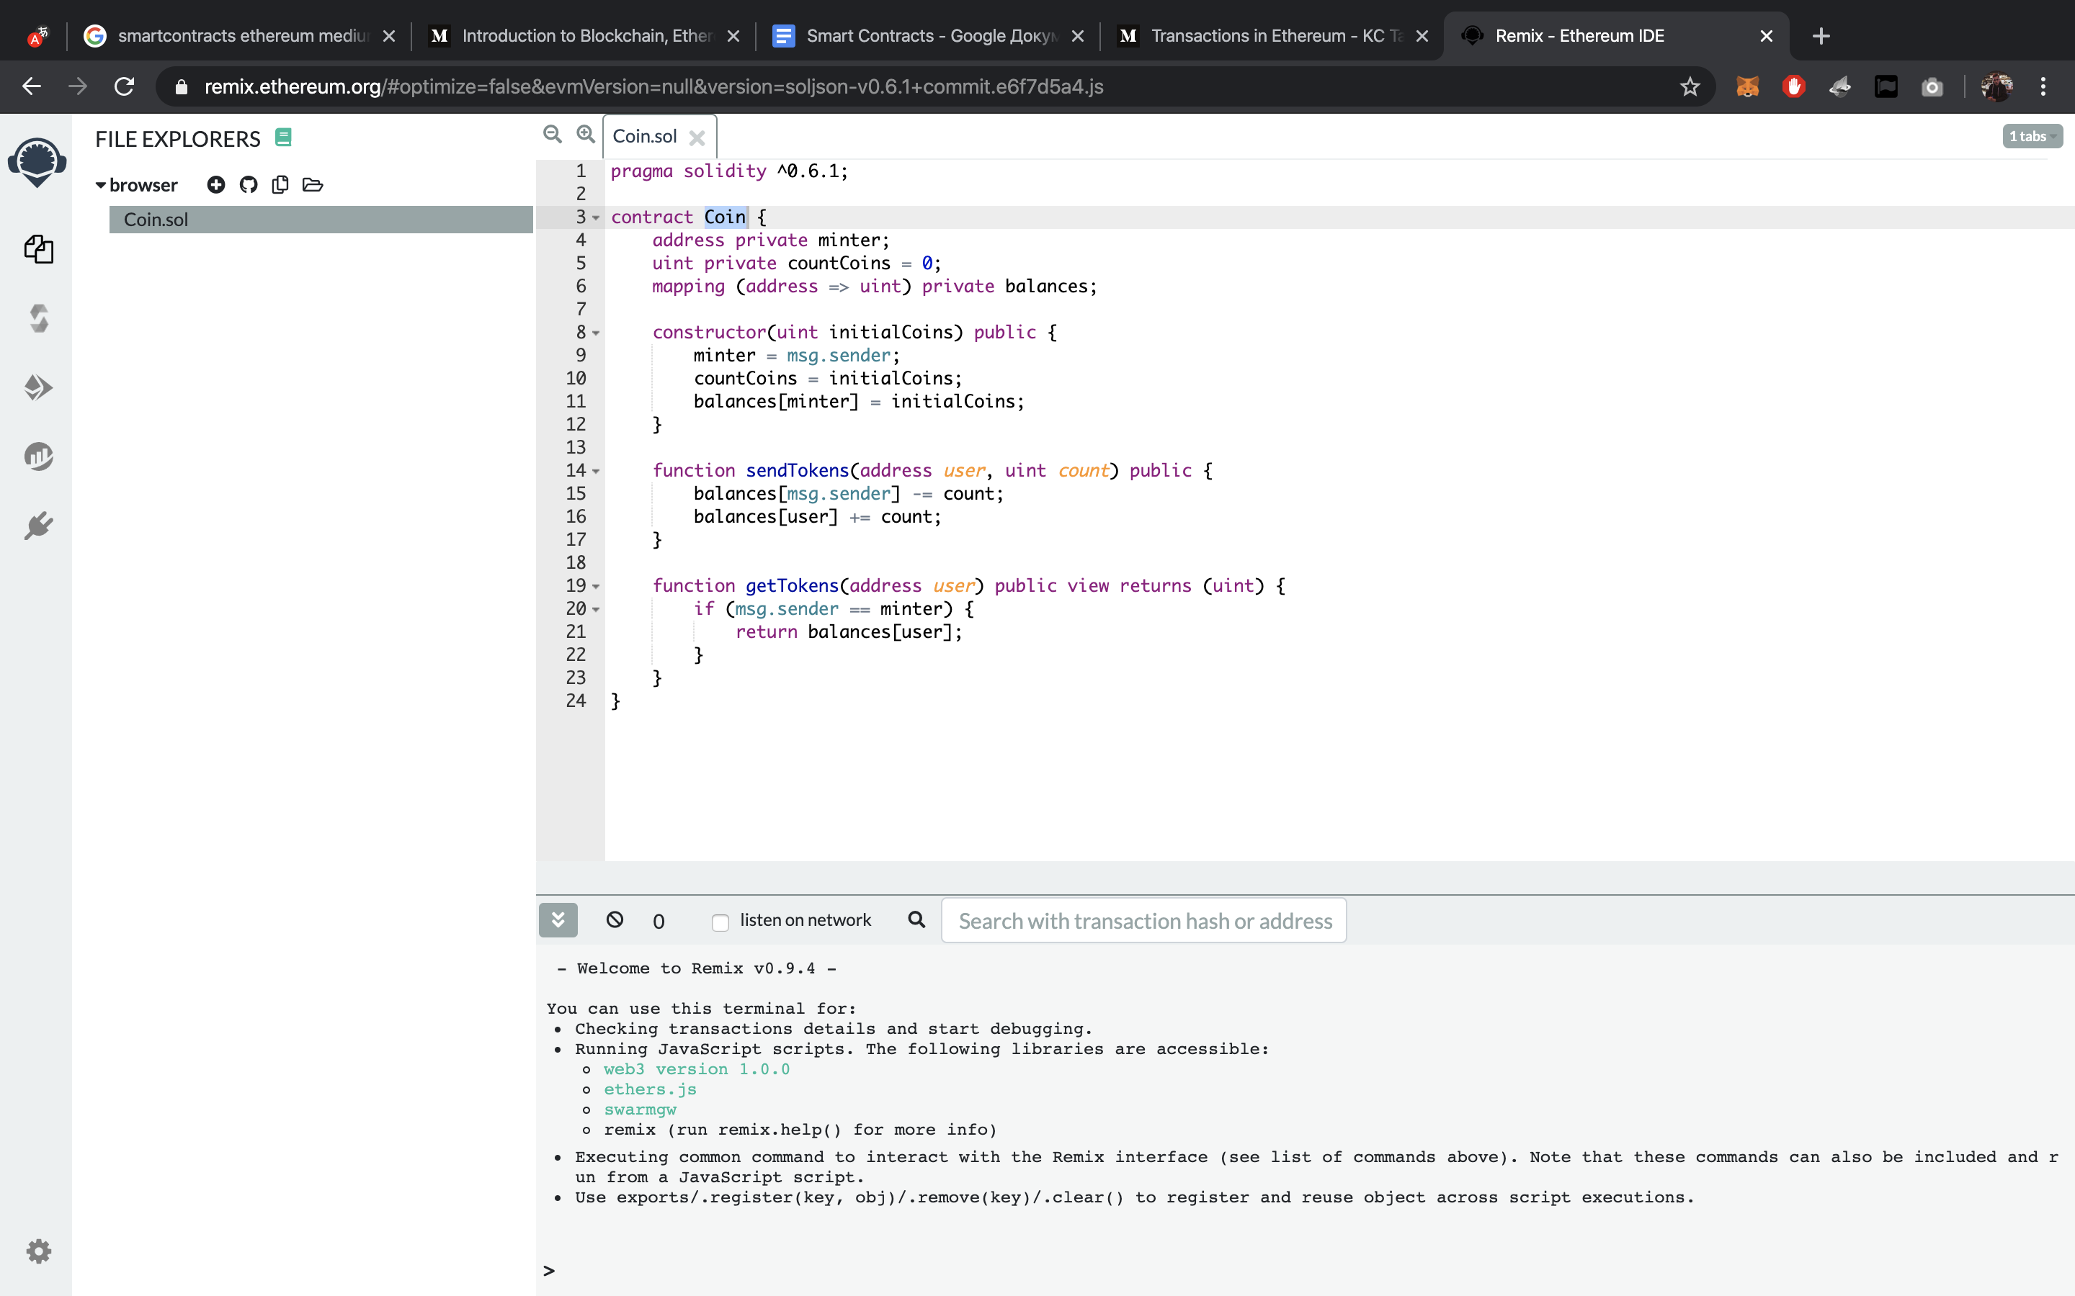
Smart Contract

Slide 10
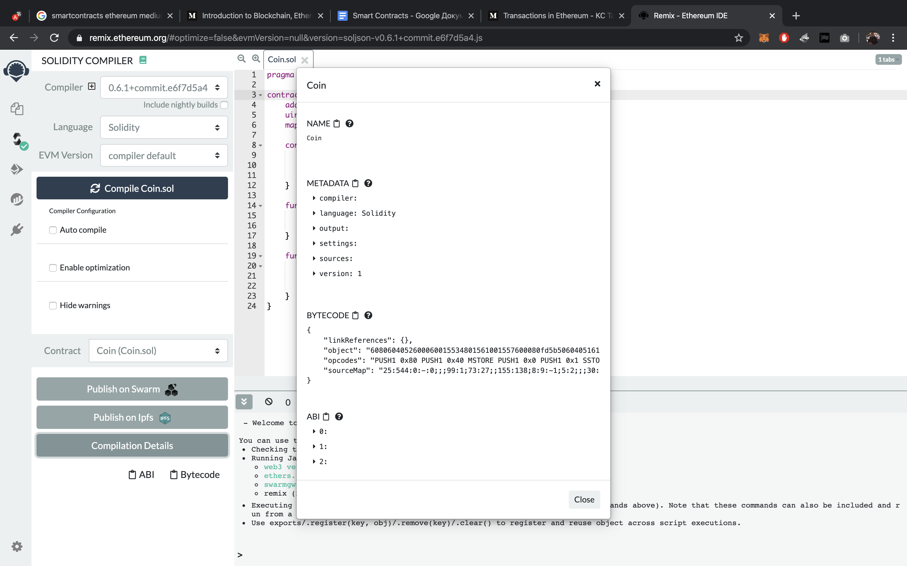
Smart Contract

Slide 11
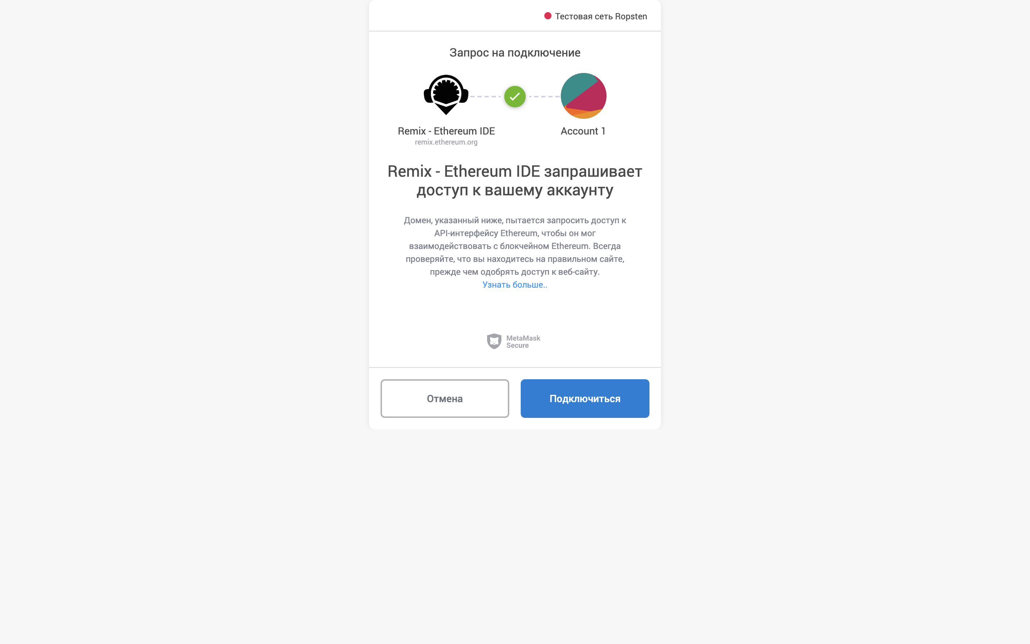
Smart Contract

Slide 12
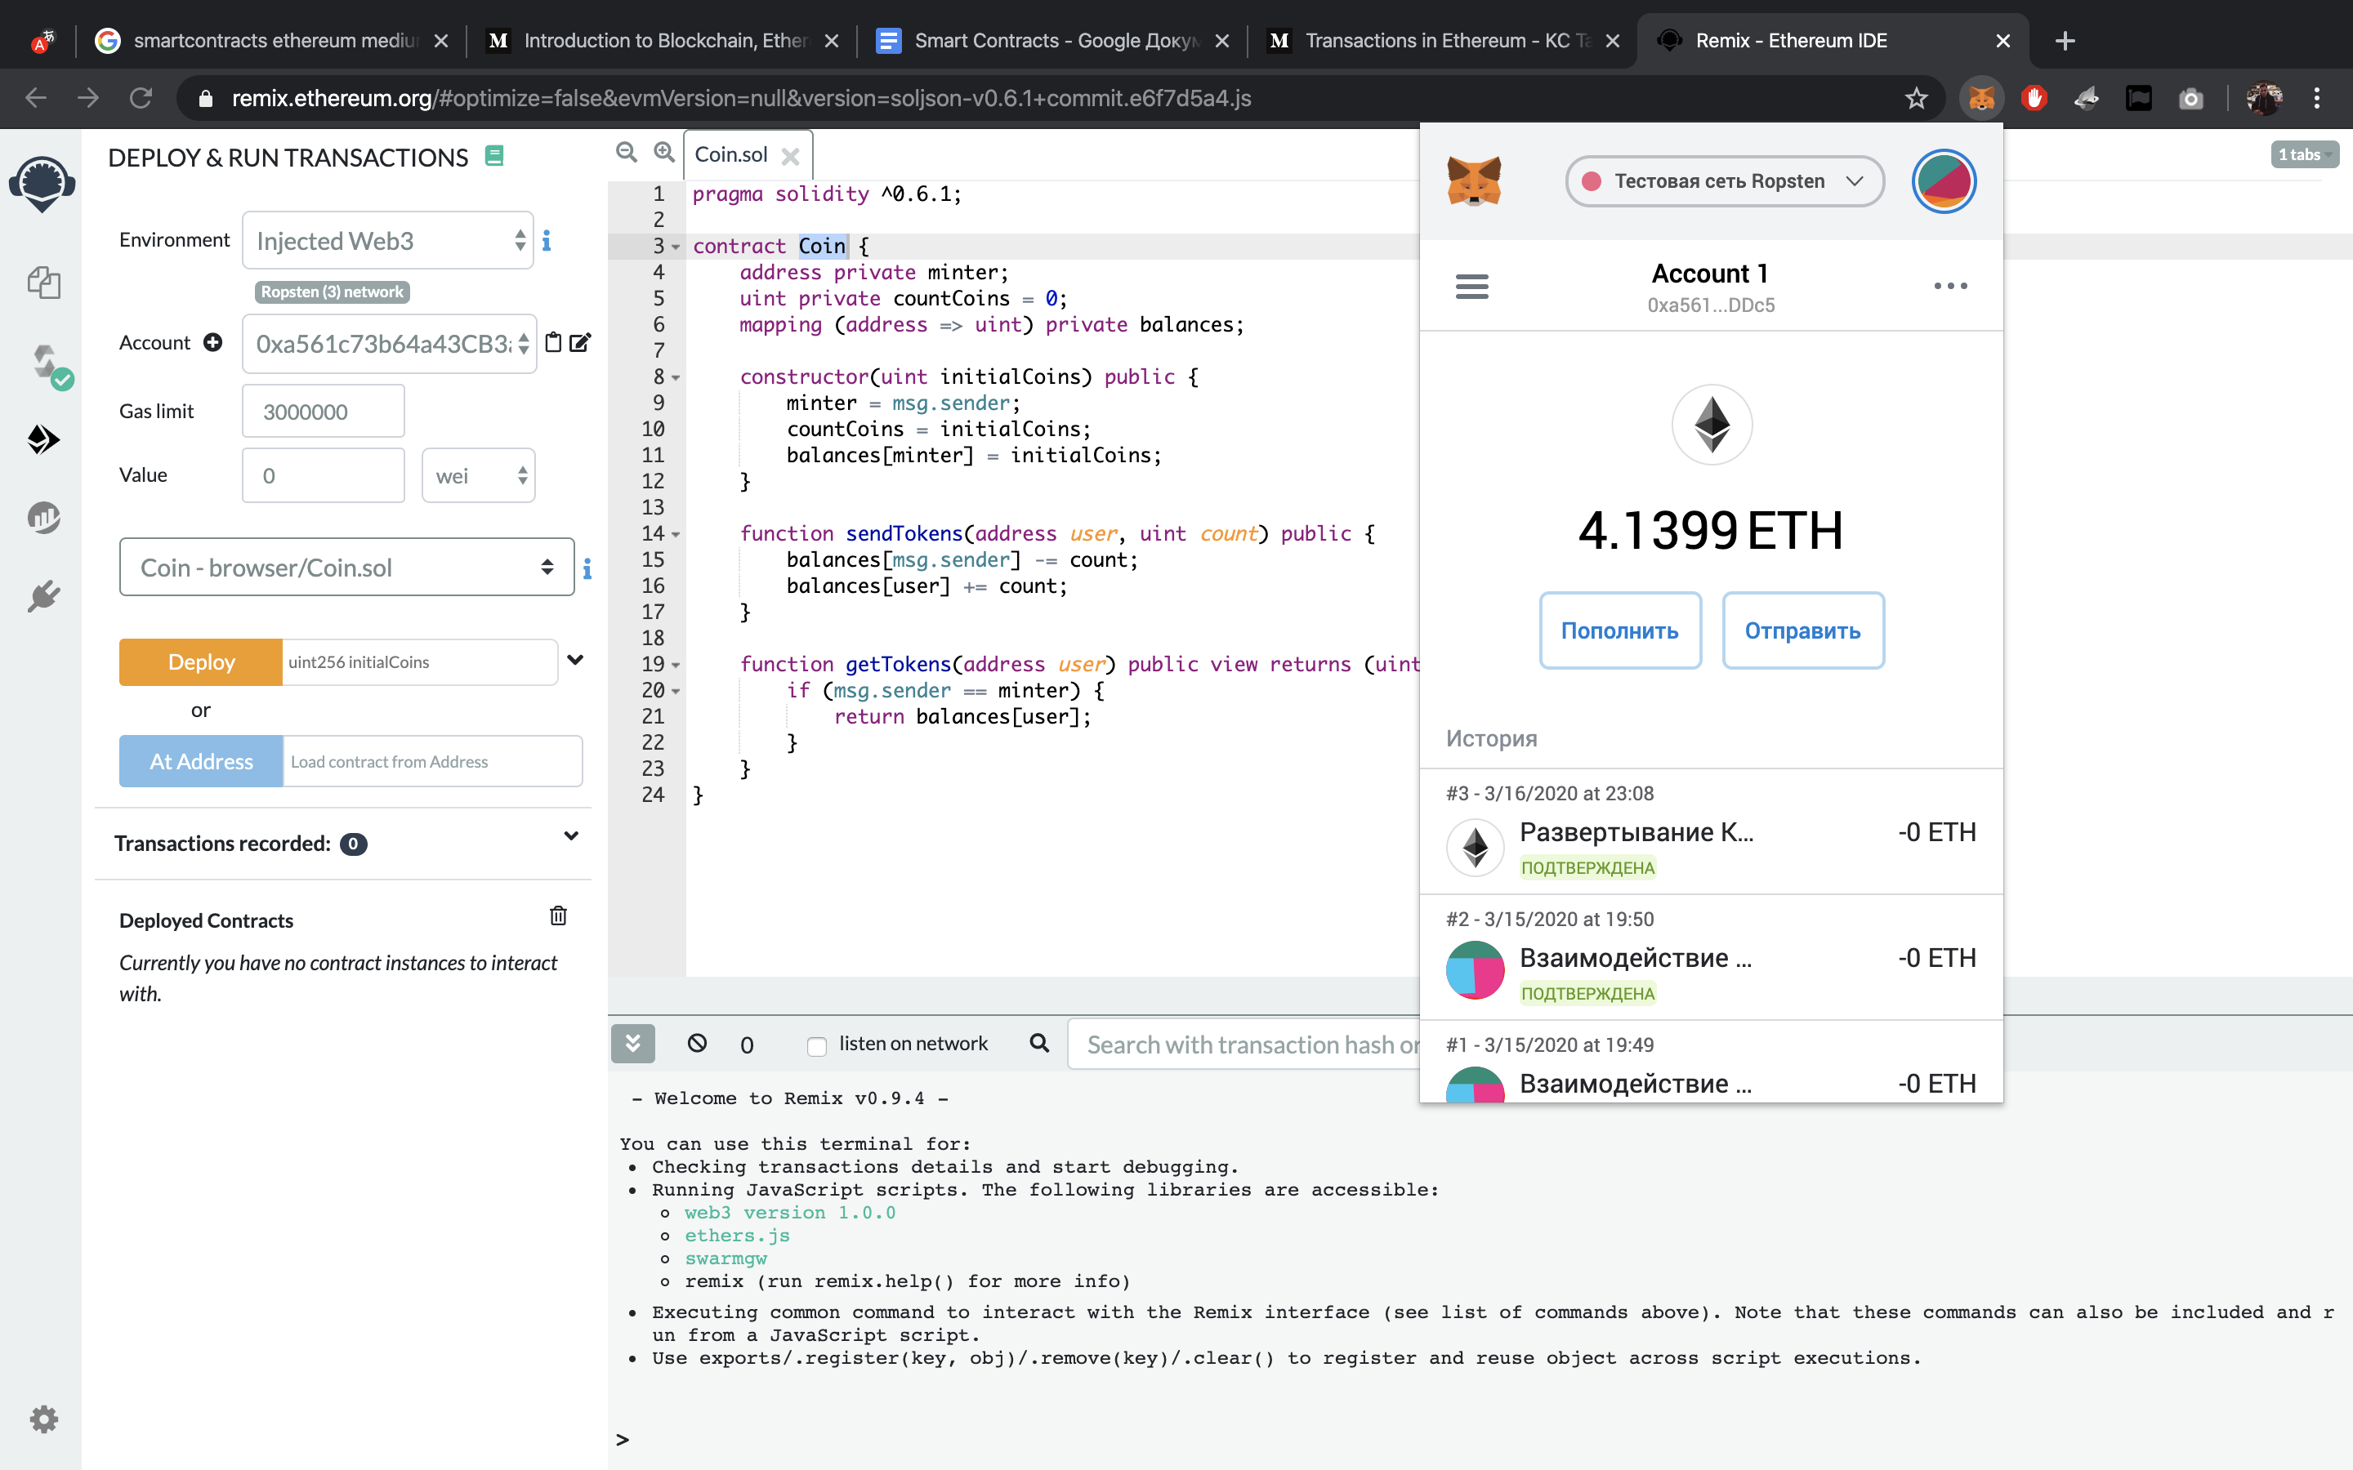
Smart Contract

Slide 13
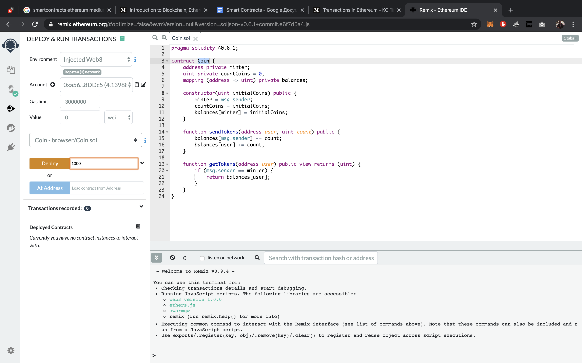
Smart Contract

Slide 14
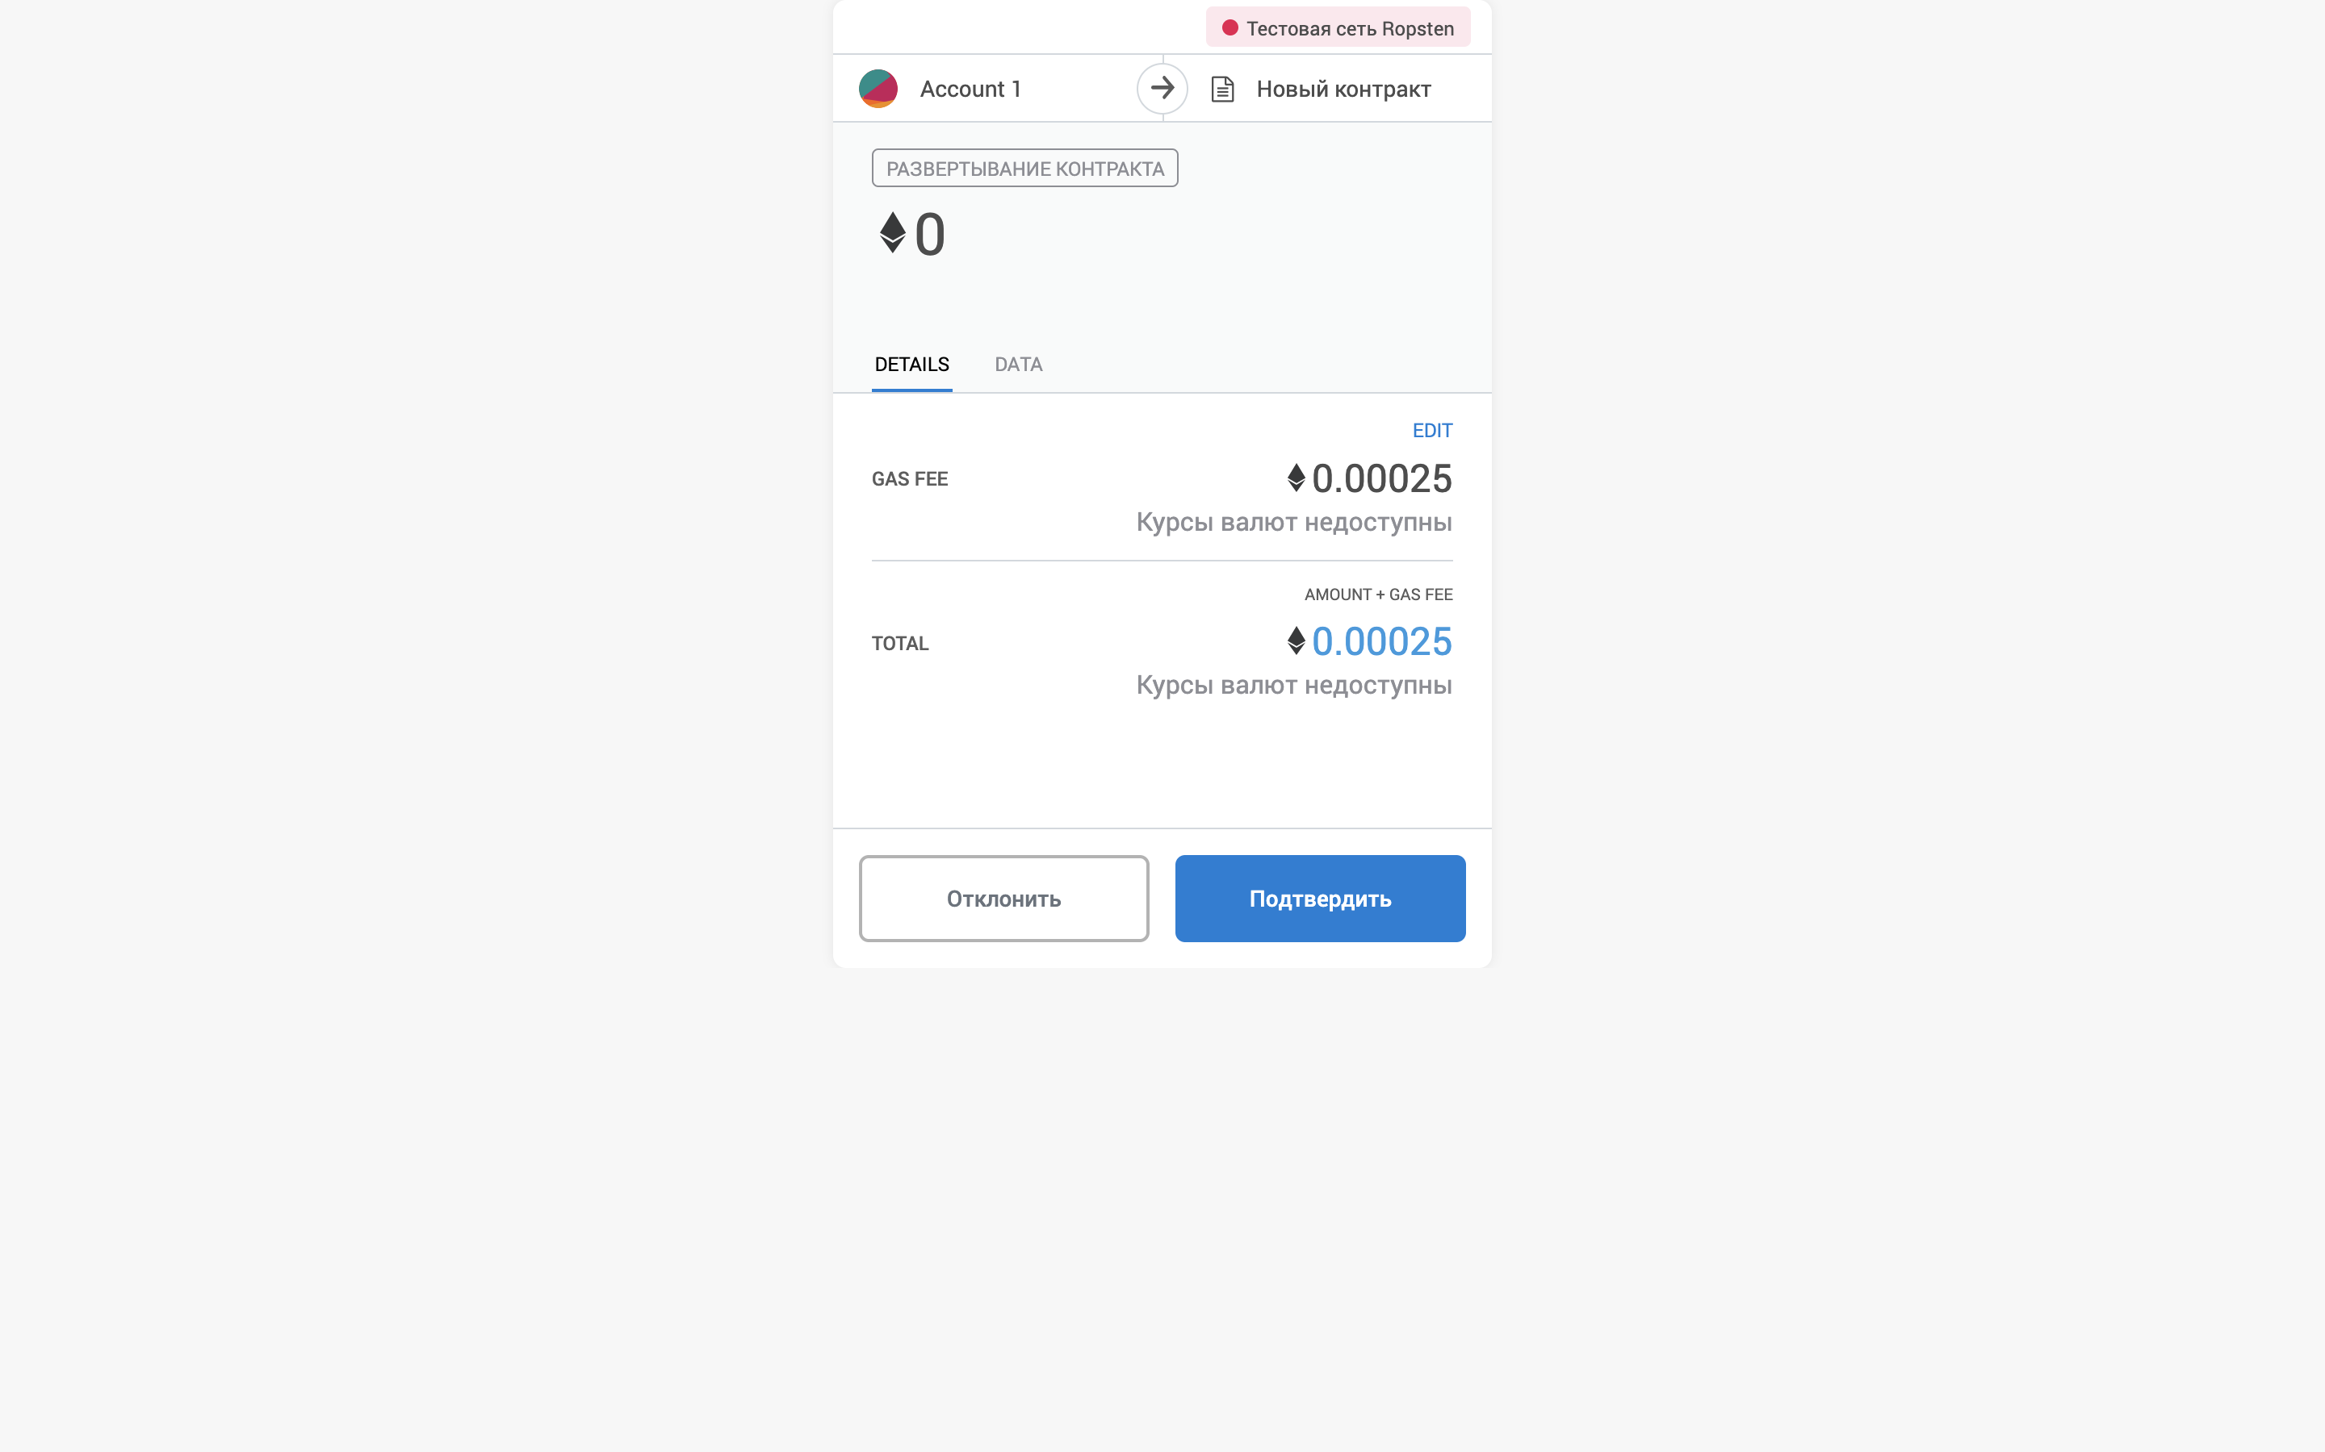
Smart Contract

Slide 15
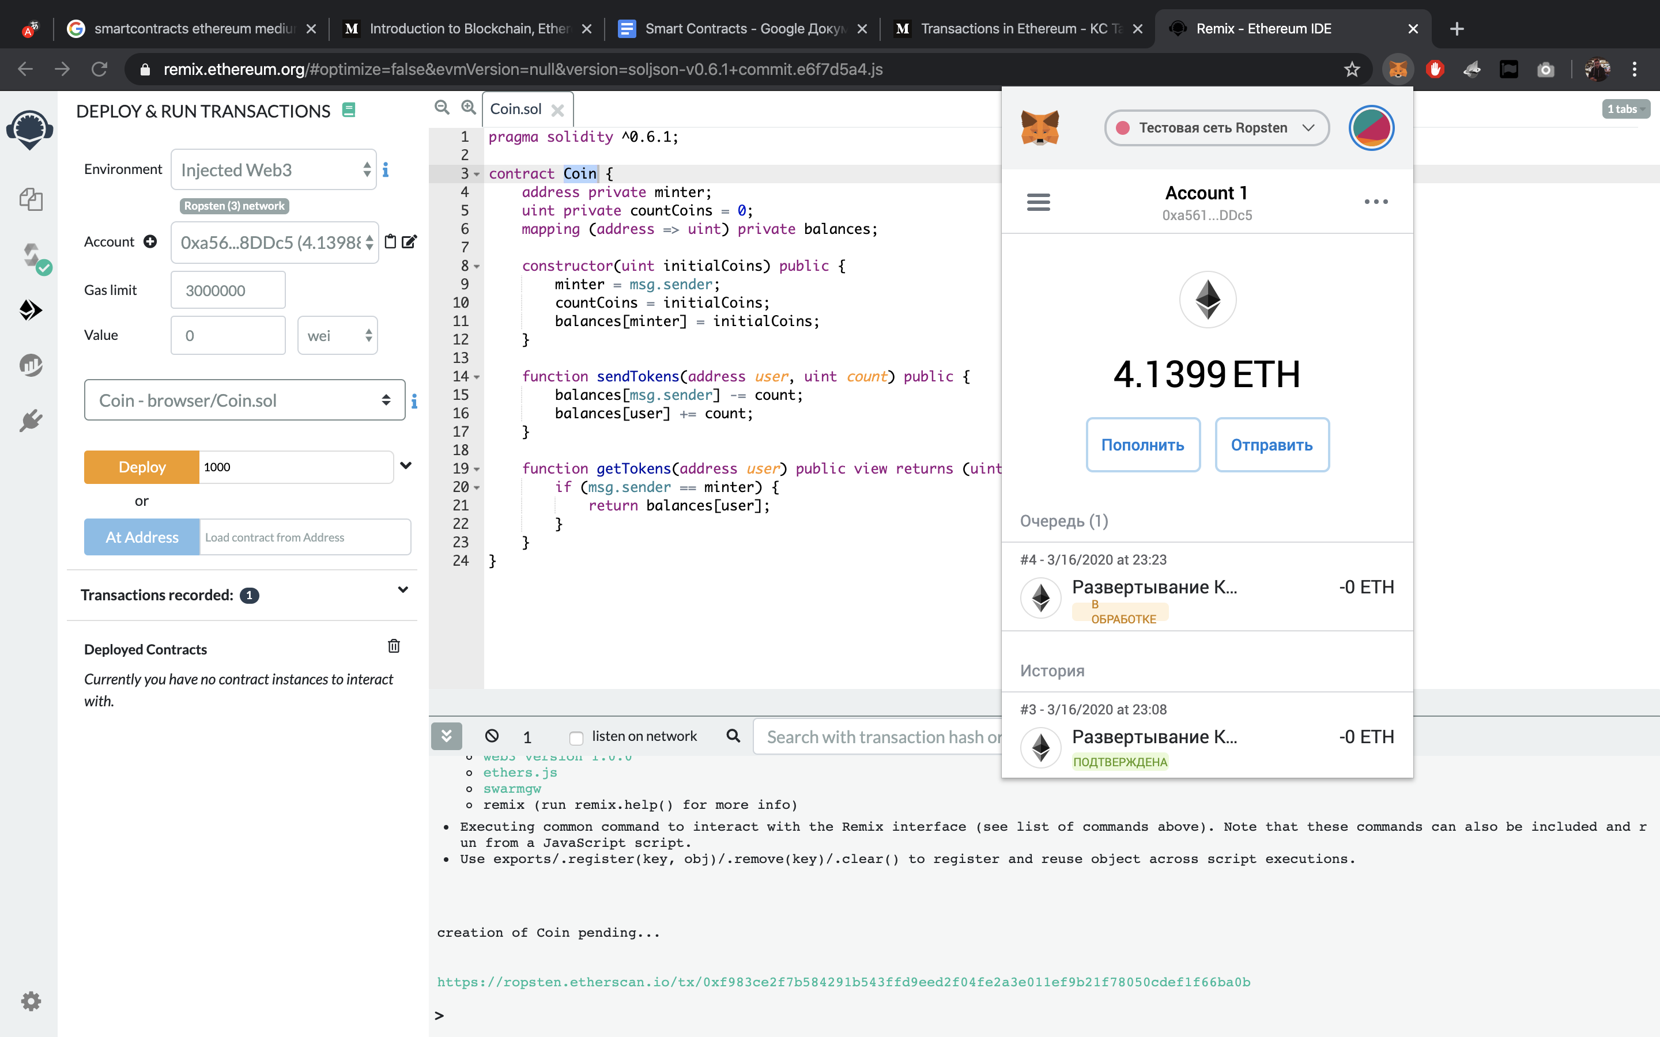
Smart Contract

Slide 16
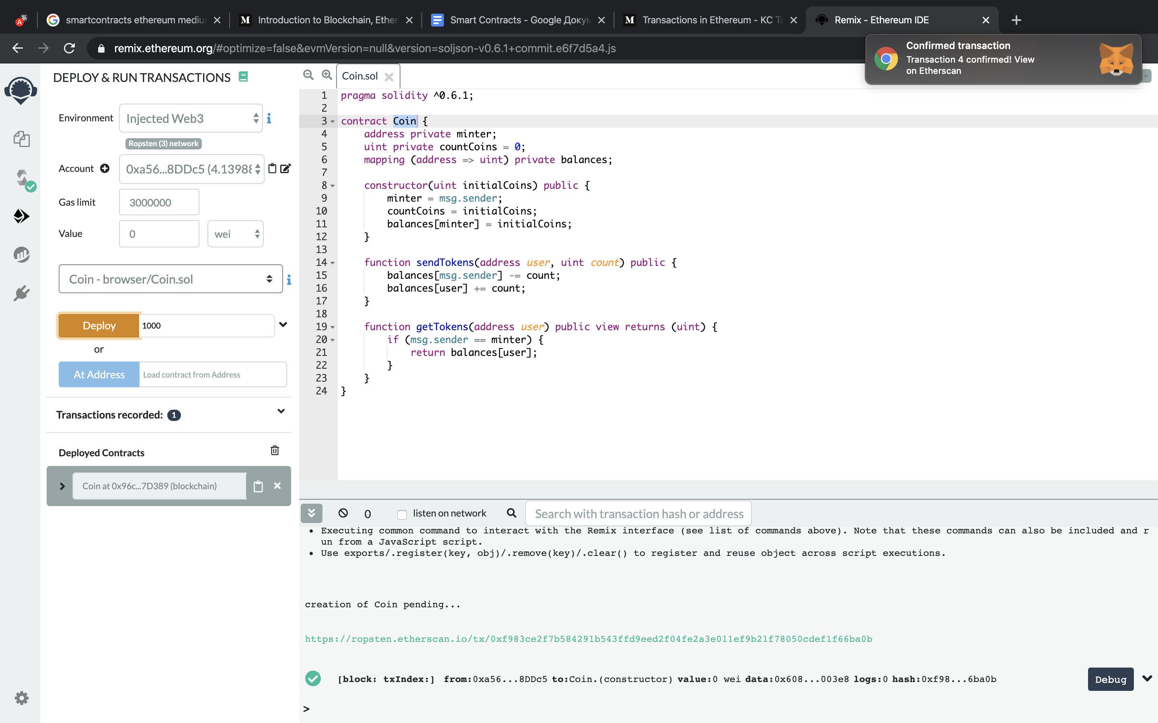
Smart Contract

Slide 17
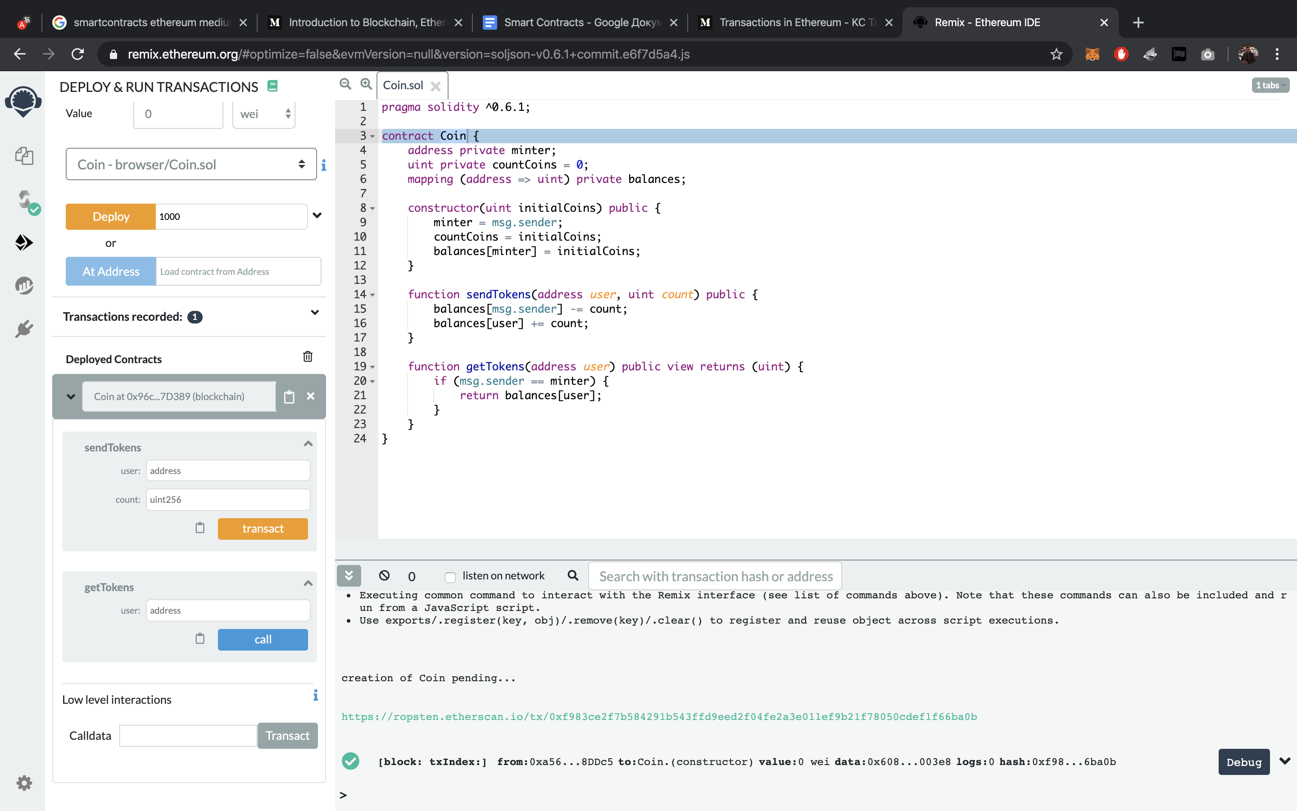
Smart Contract

Slide 18
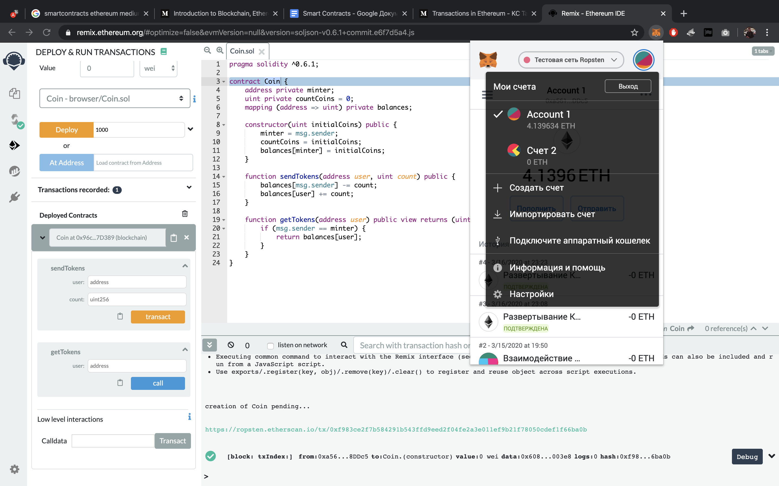
Smart Contract

Slide 19
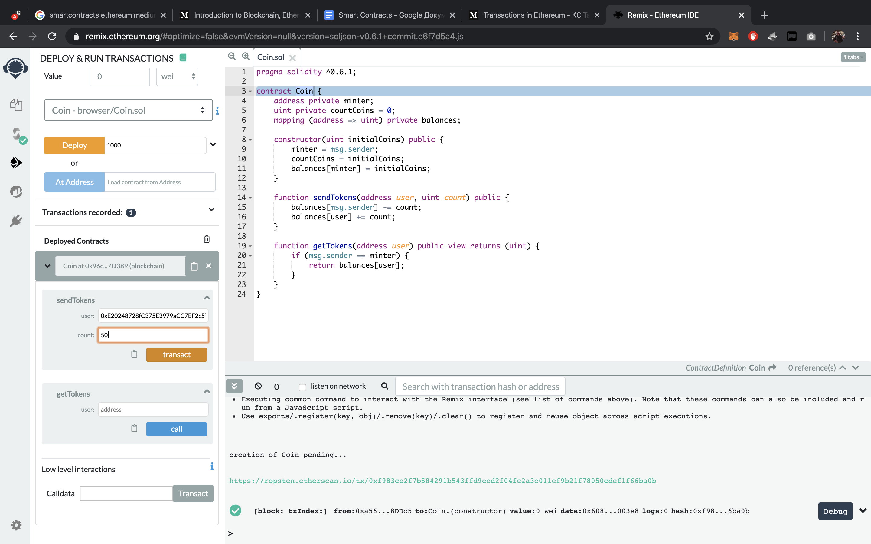
Smart Contract

Slide 20

Smart Contract

Slide 21
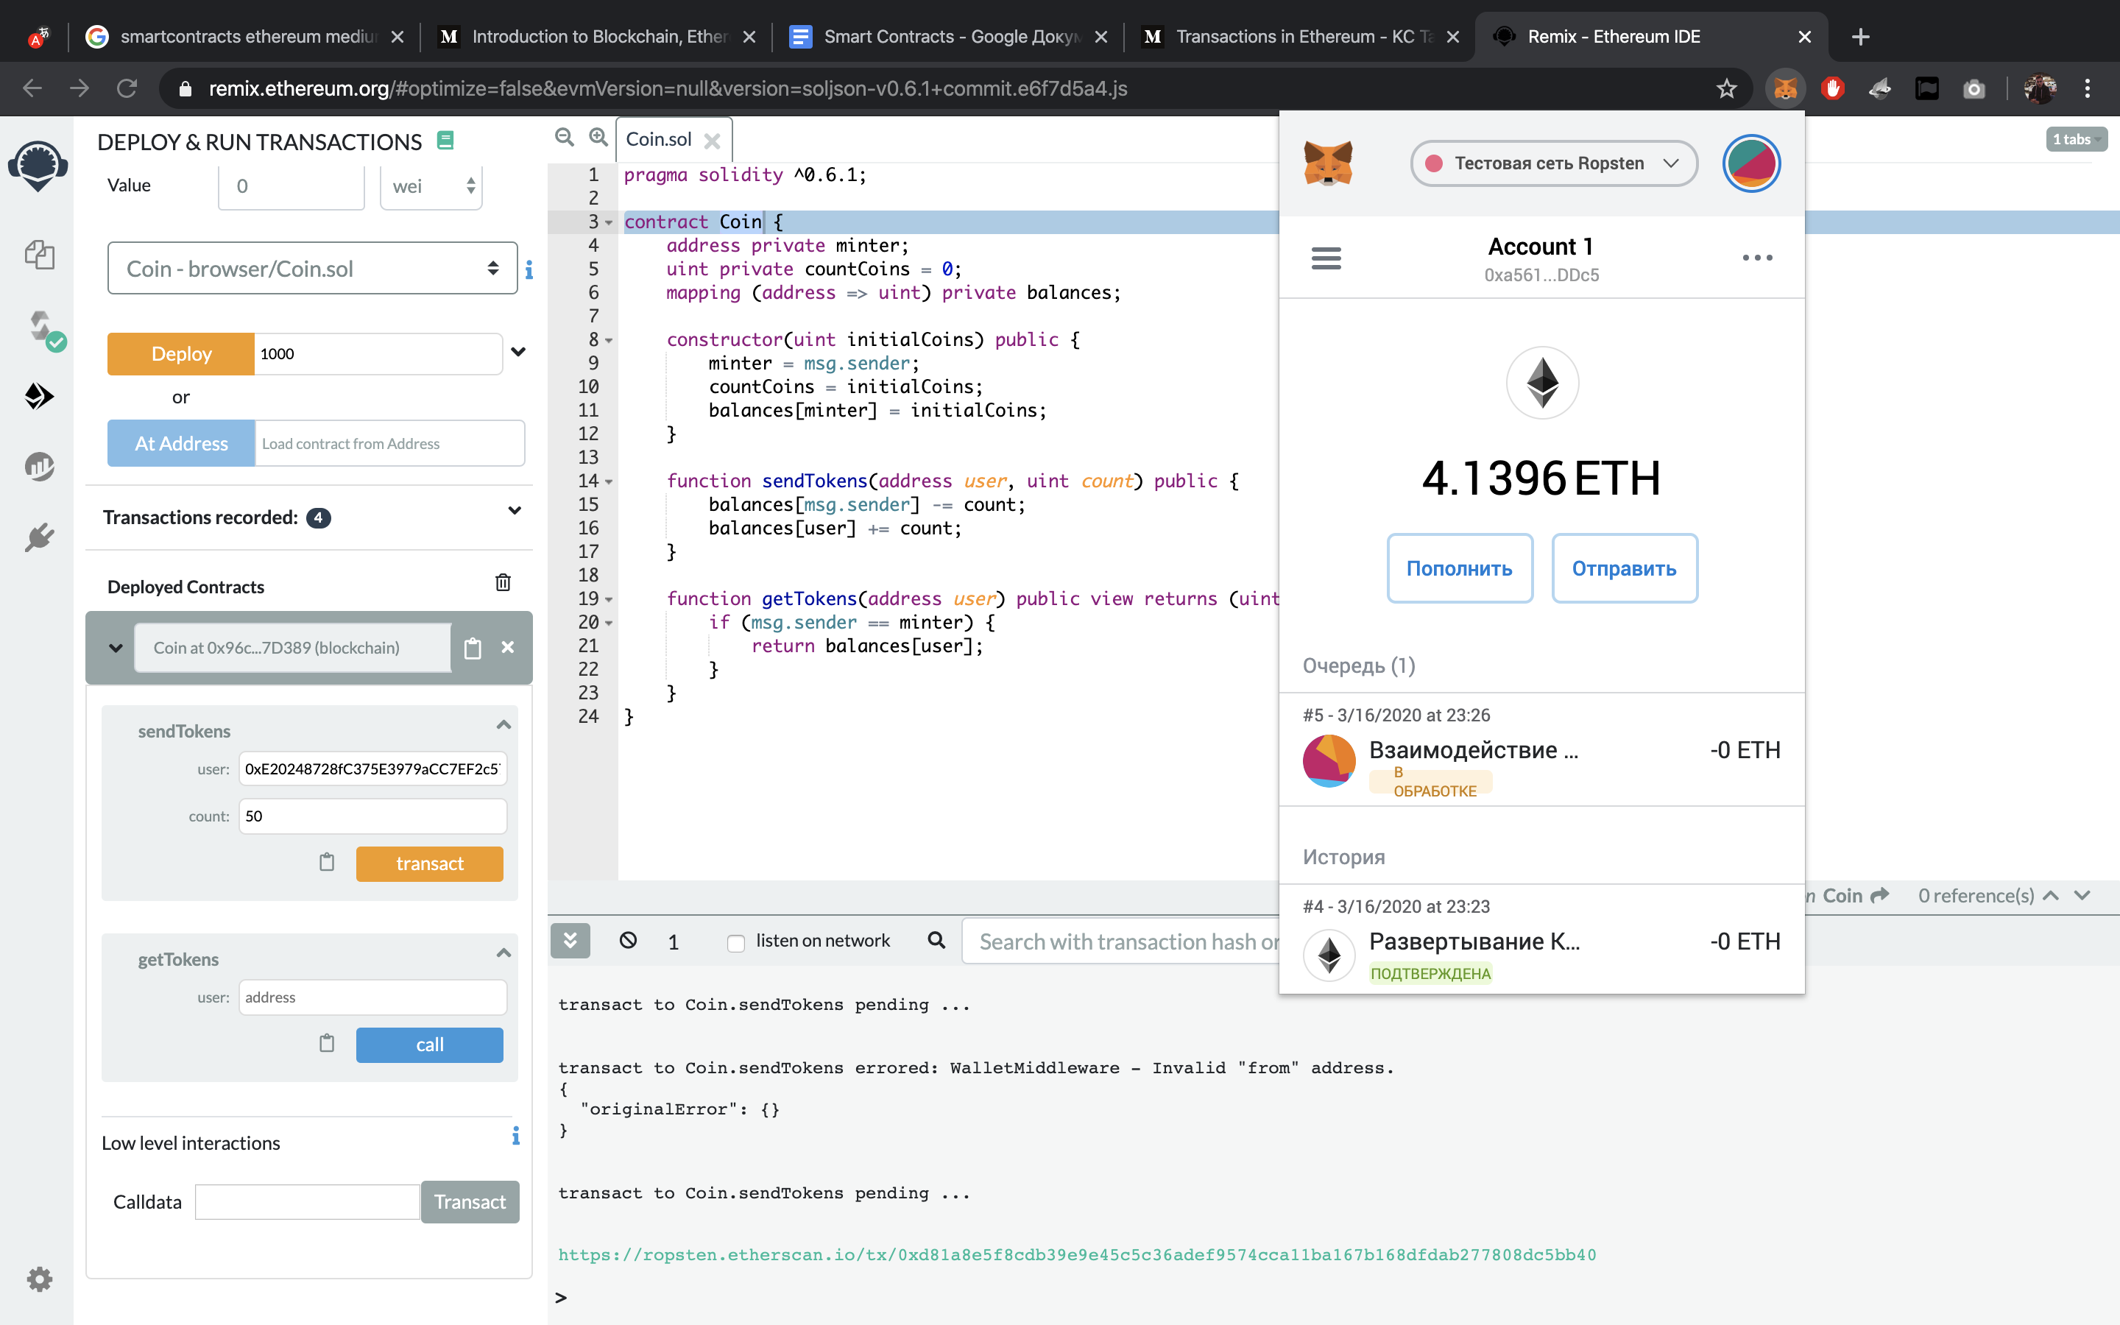
Smart Contract

Slide 22
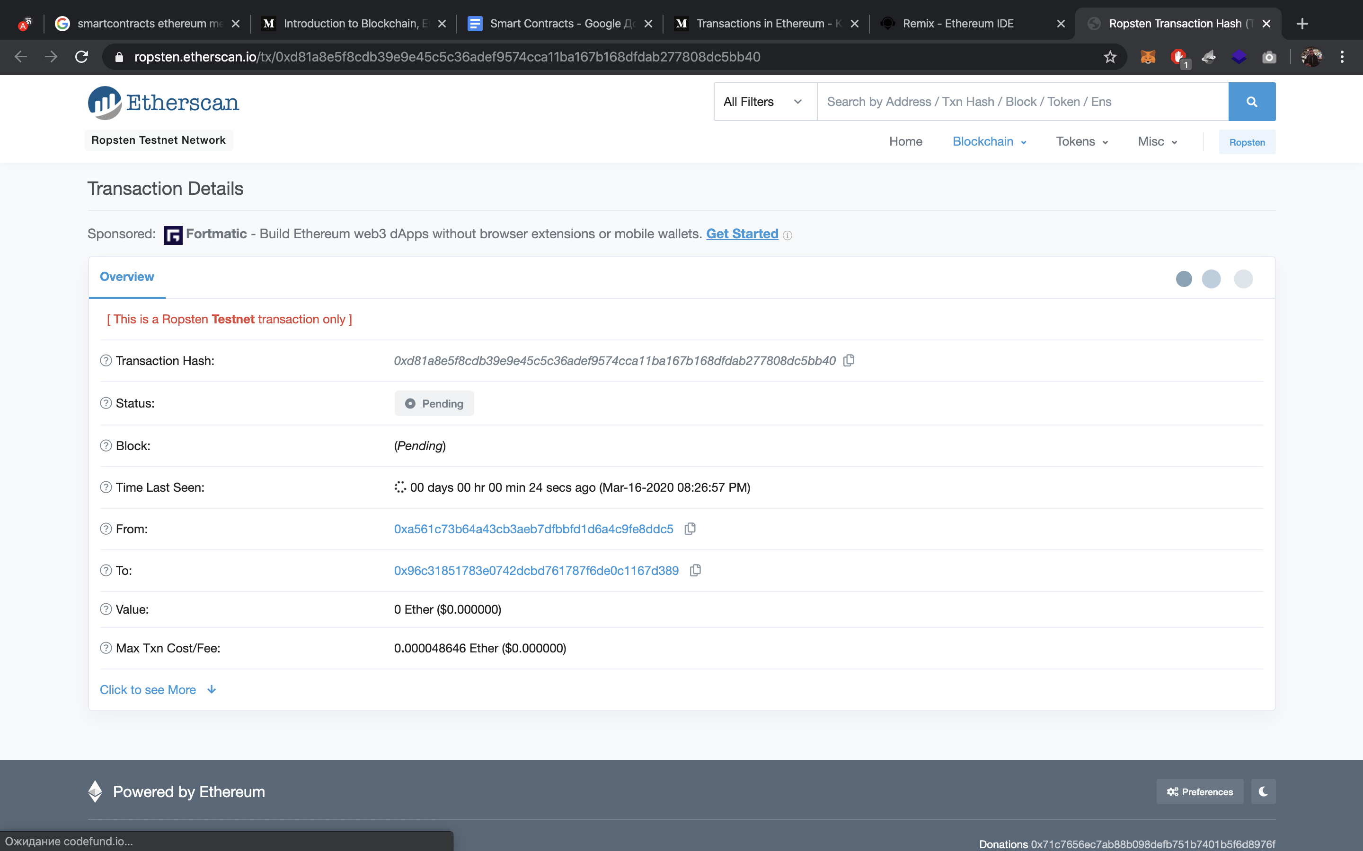
Smart Contract

Slide 23
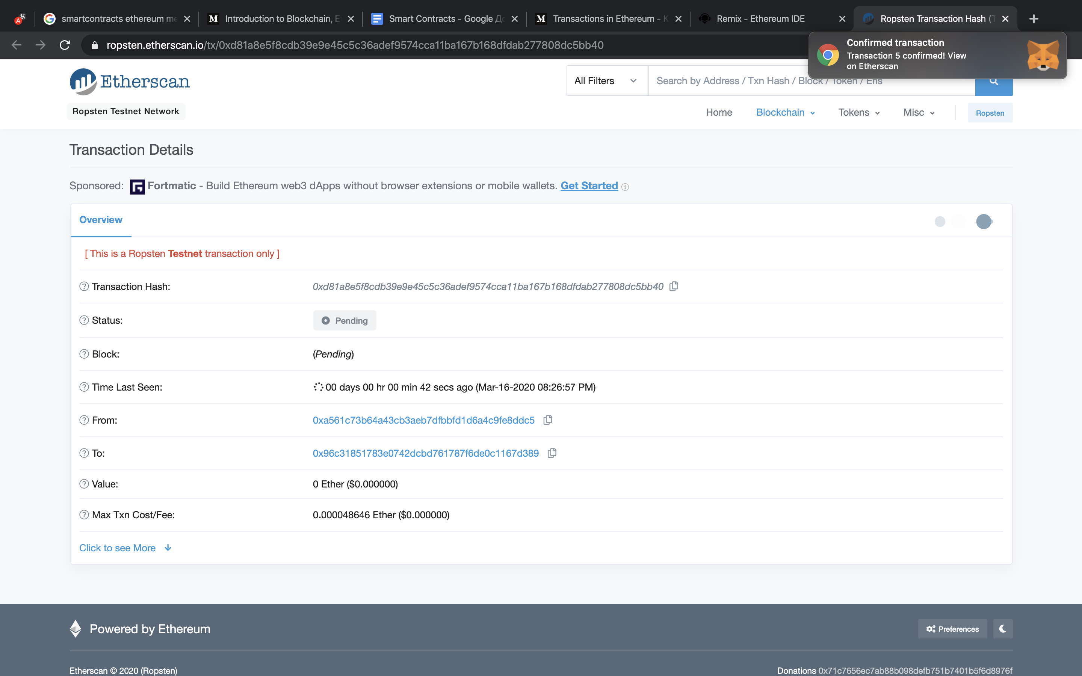
Smart Contract

Slide 24
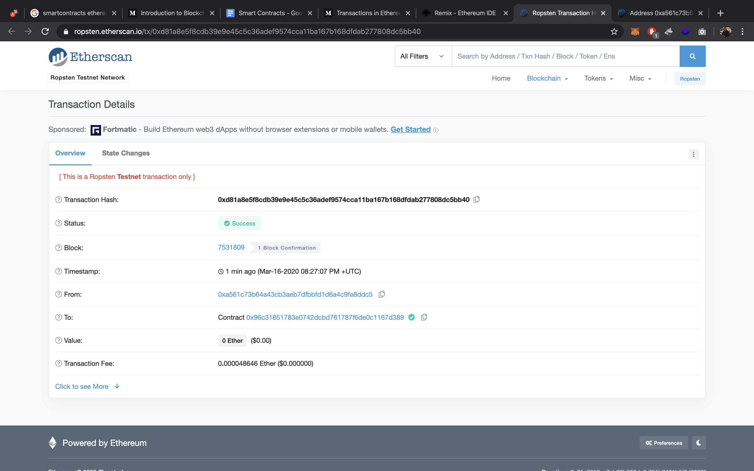
Smart Contract

Slide 25
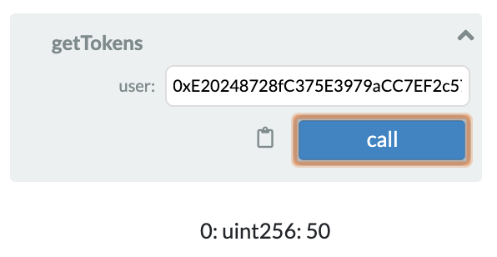
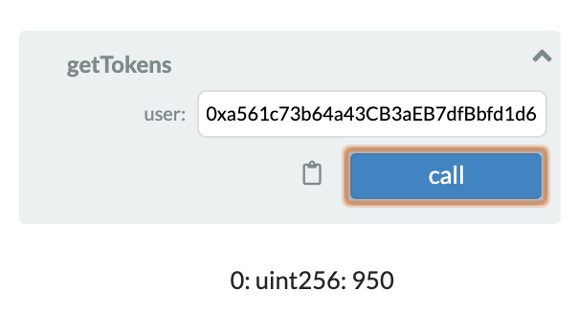
Smart Contract

Slide 26
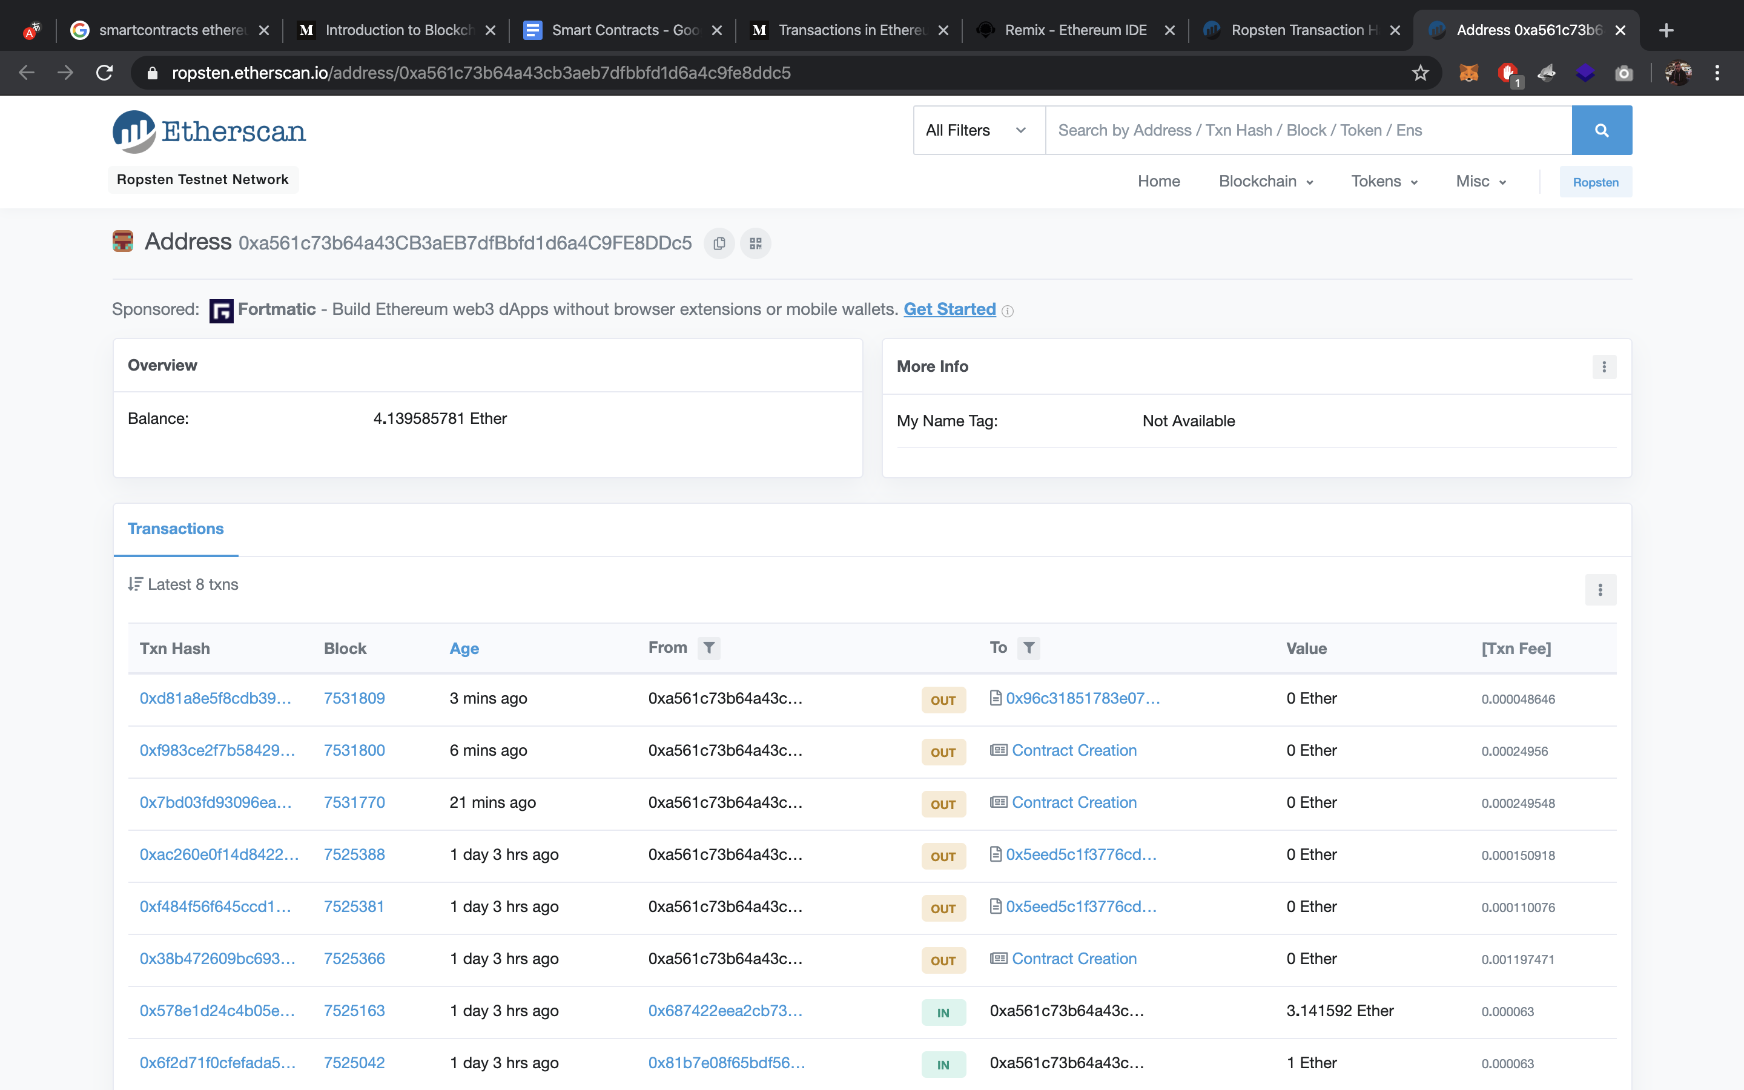
Smart Contract

Slide 27
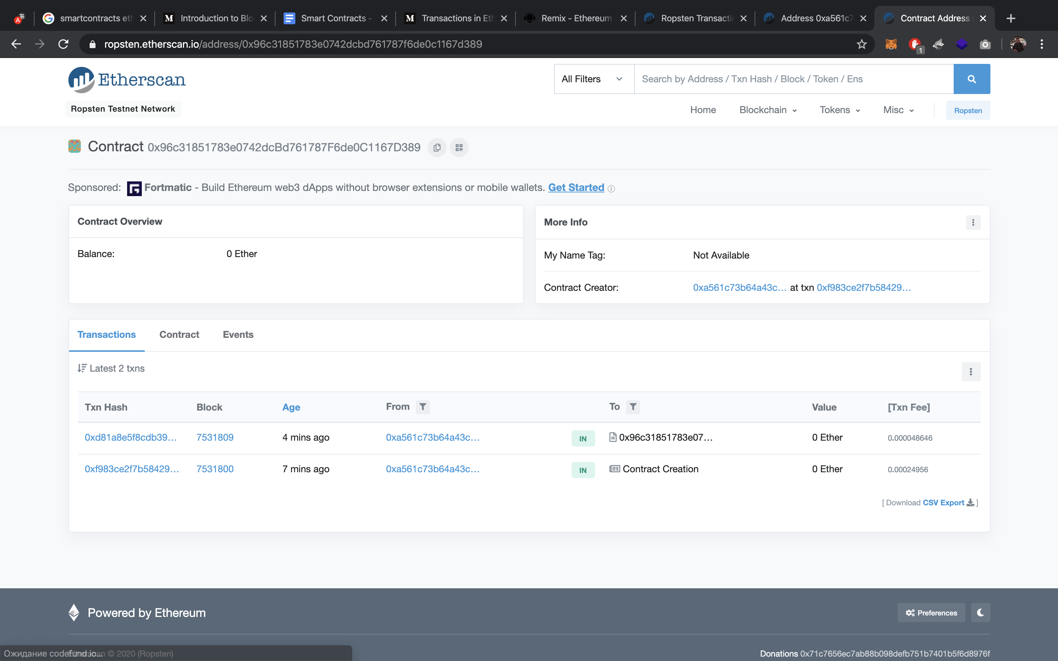
Smart Contract

